Slide 1
Unit V
Spectroscopic Techniques Introduction
Dr. P. G. Umape
Assistant Professor
First Year Engineering Department
Pune Institute of Computer Technology

Slide 2
Introduction
What is Spectroscopy?
Spectrum is a range of frequencies (electromagnetic radiations)
Analysis
It is the branch of analytical chemistry, dealing with analysis of a sample based on its interaction with electromagnetic radiations.
Mainly absorption-transmittance or emission of electromagnetic radiations are evaluated for the analysis.
Spectro
Scopy

Slide 3
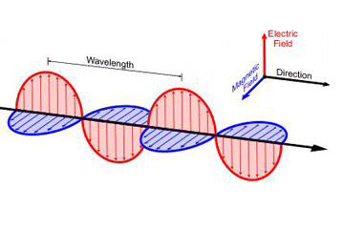
Introduction
Electromagnetic radiation?
These are the waves in which electric and magnetic field oscillates perpendicular to each other in synchronisation
The electromagnetic radiation propagate perpendicular to both electric and magnetic field.

Slide 4
Introduction
Electromagnetic radiation?
These radiations are emitted by oscillating charged particle.
Electromagnetic radiation displays the properties of both particles and waves.
The particle component is called a photon(packets of energy).
The electromagnetic spectrum composed of radiation ranging from from γ-rays to radio waves.

Slide 5
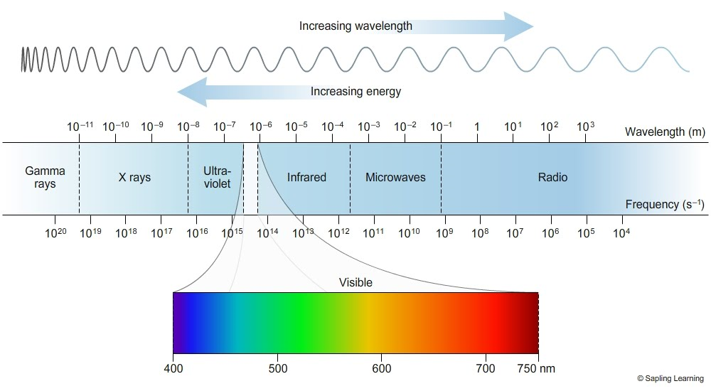
Introduction
Source: https://www.miniphysics.com/electromagnetic-spectrum_25.html

Slide 6
Introduction
The electromagnetic radiation do not require medium to propagate
The energy (E) component of a photon is proportional to the frequency (ν).
E = hν
Where h is Planck’s constant and ν is the frequency in Hertz (cycles per second)

Slide 7
Introduction
As the frequency ν (number of cycles of the wave per second) is proportional to the speed of radiation, (which is constant = 3 x 10⁸ m/s ) and inversely proportional wavelength.
As E = hν

Slide 8
Introduction
How the interaction between EMR and Matter takes place?
When electromagnetic radiation interacts with matter, then it may get reflected, transmitted or absorbed.
The atomic particle in a sample/matter also posses wave and particle nature.
Which allows interaction of EM radiation with matter.
The interaction of electromagnetic radiation and matter takes place by two ways.

Slide 9
Introduction
How the interaction between EMR and Matter takes place?
Collision: Here particle-to-particle collision takes place and there is a loss of energy as heat and movement.
Coupling – When the wave property of the radiation matches the wave property of the particle then the coupling of EMR and particle energy (frequency) takes place and particle attain the next higher quantum mechanical energy level

Slide 10
Introduction
Based on the interaction of EMR with matter i.e. It is absorbed or emitted by the matter spectroscopy is classified as Absorption spectroscopy and Emission spectroscopy,
Here we will focus on Absorption spectroscopy.
Following is the list of different absorption spectroscopy
X-ray absorption spectroscopy, UV-Vis absorption spectroscopy
Infrared absorption spectroscopy, Microwave absorption spectroscopy, Nuclear Magnetic resonance spectroscopy, Electron spin resonance spectroscopy

Slide 11
Summary
What is spectroscopy?
What are electromagnetic radiation?
Which radiations contribute to the electromagnetic spectrum?
How the interaction between EMR and matter takes place?
What is absorption spectroscopy?
What are the types of absorption spectroscopy?

